Slide 1
Chapter 5
Addressing Modes

Slide 2
Outlines
Five addressing modes of 8051
Code instructions using each addressing mode
Access RAM using various addressing modes
SFR addresses
Access SFR
Operate stack using direct addressing mode
Code instructions to operate look-up table

Slide 3
Five Addressing Modes
Immediate
Register
Direct
Register indirect
Indexed

Slide 4
Immediate Addressing Mode
MOV A,#25H ;load 25H into A
MOV R4,#62 ;load the decimal value 62 into R4
MOV B,#40H ;load 40H into B
MOV DPTR,#4521H ;DPTR=4521H
MOV DPTR,#2550H
;is the same as:
MOV DPL,#50H
MOV DPH,#25H

Slide 5
MOV DPTR,#68975 ;illegal!! value > 65535 (FFFFH)
COUNT EQU 30
… …
MOV R4,#COUNT ;R4=1E (30=1EH)
MOV DPTR,#MYDATA ;DPTR=200H
ORG 200H
MYDATA: DB “America”

Slide 6
Register Addressing Mode
MOV A,R0 ;copy the contents of R0 into A
MOV R2,A ;copy the contents of A into R2
ADD A,R5 ;add the contents of R5 to contents of A
ADD A,R7 ;add the contents of R7 to contents of A
MOV R6,A ;save accumulator in R6
MOV DPTR,#25F5H
MOV R7,DPL
MOV R6,DPH

Slide 7
Direct Addressing Mode
RAM addresses 00 to 7FH
MOV R0,40H ;save content of RAM location 40H in R0
MOV 56H,A ;save content of A in RAM location 56H
MOV R4,7FH ;move contents of RAM location 7FH to R4
MOV A,4 ;is same as
MOV A,R4 ;which means copy R4 into A
MOV A,7 ;is same as
MOV A,R7 ;which means copy R7 into A

Slide 8
MOV A,2 ;is the same as
MOV A,R2 ;which means copy R2 into A
MOV A,0 ;is the same as
MOV A,R0 ;which means copy R0 into A
MOV R2,#5 ;R2=05
MOV A,2 ;copy R2 to A (A=R2=05)
MOV B,2 ;copy R2 to B (B=R2=05)
MOV 7,2 ;copy R2 to R7
;since “MOV R7,R2” is invalid

Slide 9
SFR Registers & Their Addresses
MOV 0E0H,#55H ;is the same as
MOV A,#55H ;which means load 55H into A (A=55H)
MOV 0F0H,#25H ;is the same as
MOV B,#25H ;which means load 25H into B (B=25H)
MOV 0E0H,R2 ;is the same as
MOV A,R2 ;which means copy R2 into A
MOV 0F0H,R0 ;is the same as
MOV B,R0 ;which means copy R0 into B

Slide 10
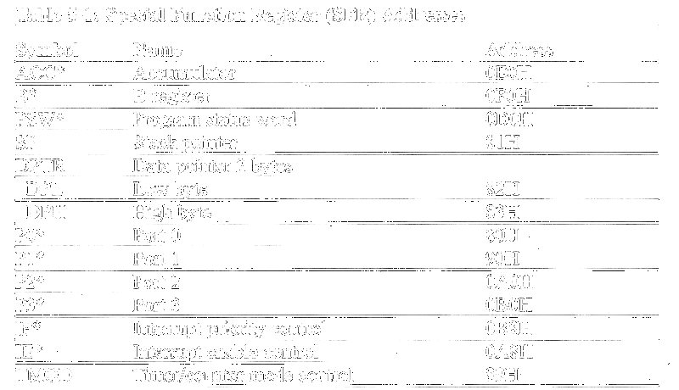
SFR Addresses ( 1 of 2 )

Slide 11
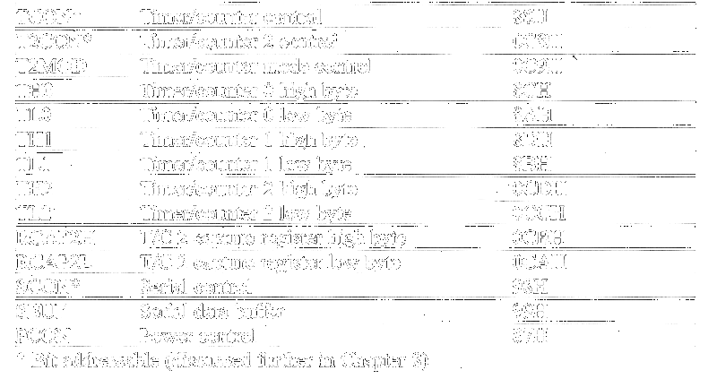
SFR Addresses ( 2 of 2 )

Slide 12
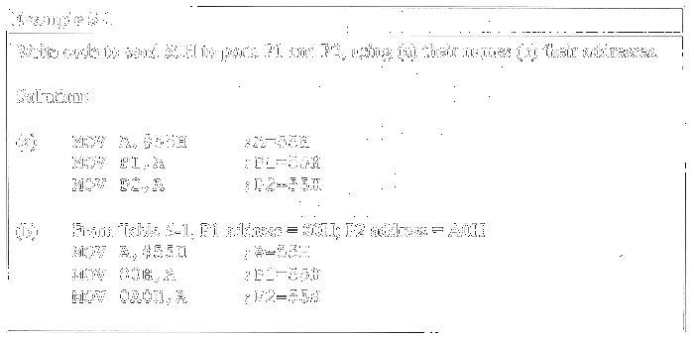
Example

Slide 13
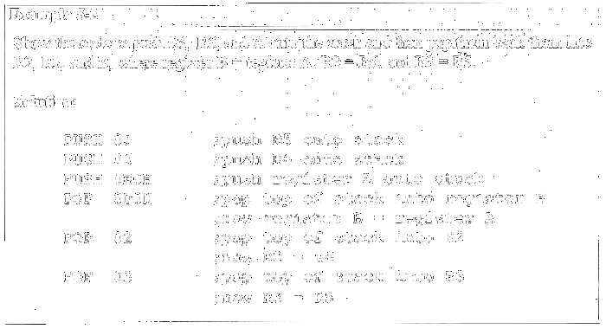
Stack and Direct Addressing Mode
Only direct addressing is allowed for stack

Slide 14
Register Indirect Addressing Mode
Only R0 & R1 can be used
MOV A,@R0 ;move contents of RAM location whose
;address is held by R0 into A
MOV @R1,B ;move contents of B into RAM location
;whose address is held by R1

Slide 15
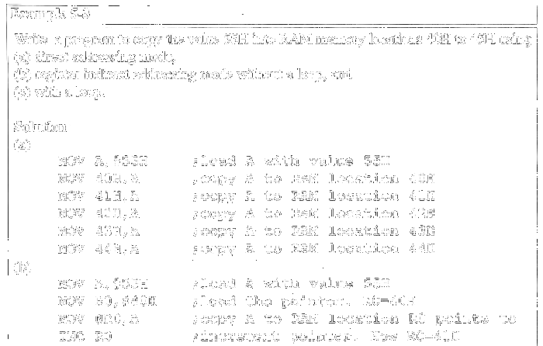
Example ( 1 of 2 )

Slide 16
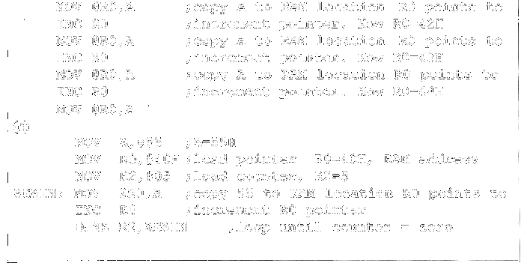
Example ( 2 of 2 )

Slide 17
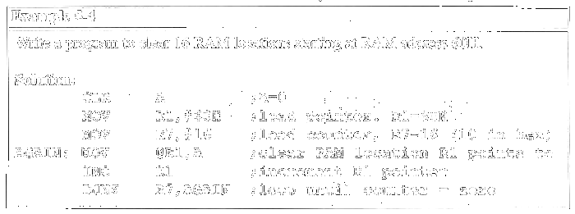
Advantage of Register Indirect Addressing
Looping not possible in direct addressing

Slide 18
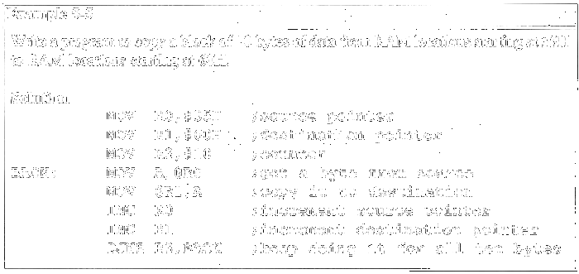
Example

Slide 19
Index Addressing Mode & On-chip ROM Access
Limitation of register indirect addressing: 8-bit addresses (internal RAM)
DPTR: 16 bits
MOVC A, @A+DPTR ; “C” means program (code) space ROM

Slide 20
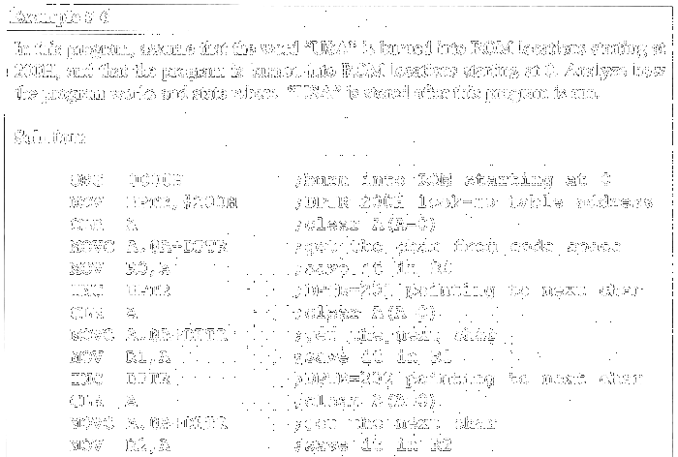
Example ( 1 of 2 )

Slide 21
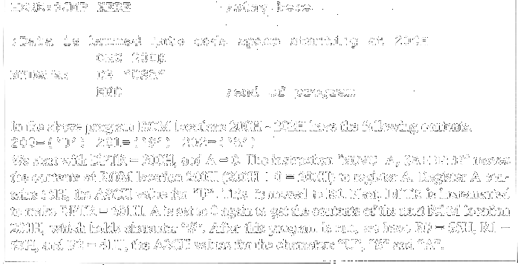
Example ( 2 of 2 )

Slide 22
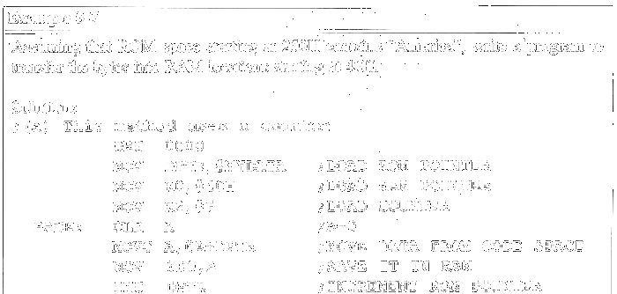
Example ( 1 of 3 )

Slide 23
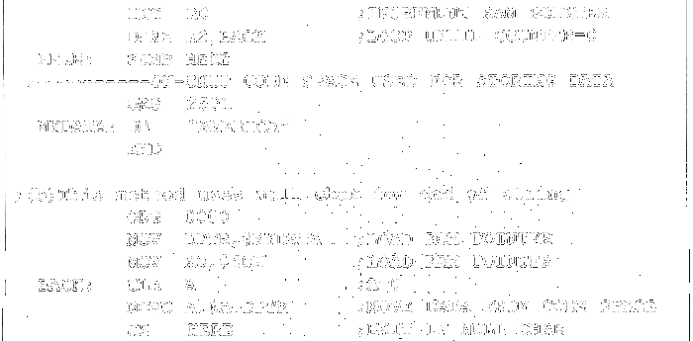
Example ( 2 of 3 )

Slide 24
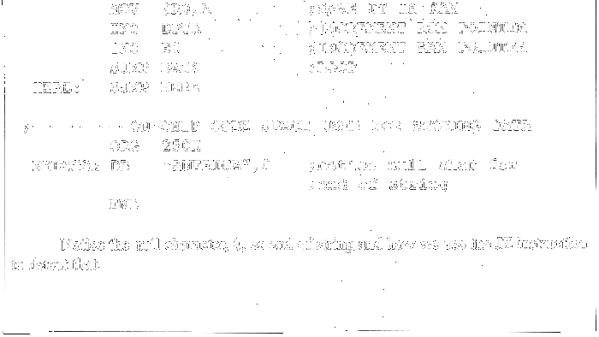
Example ( 3 of 3 )

Slide 25
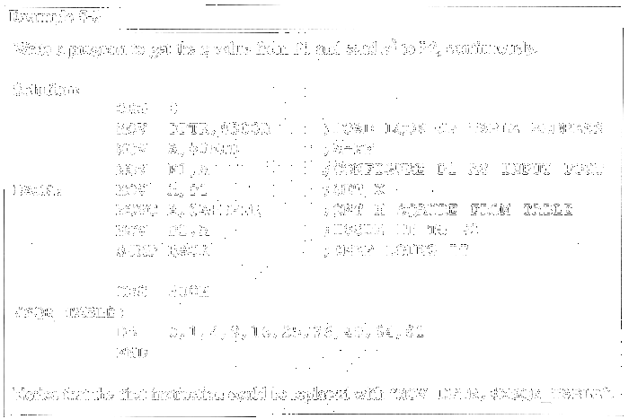
Look-up Table & Indexed Addressing

Slide 26
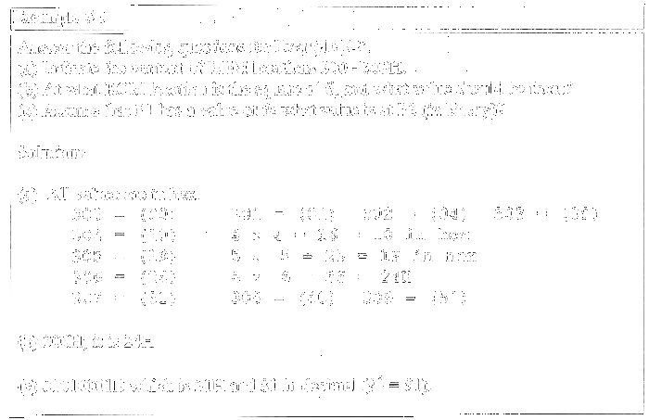
Example

